Slide 1
A Preliminary Foray into Early English Books Online
By Jordan Sellers

Slide 2
Research Problem
Given the vocabulary, especially spelling, can we predict which decade a book was written in?
Destructive VS non-destructive dating methods

Slide 3
Data
Scraped about 1700 books from Early English Books online, and counted how often each word showed up. Originally, this had more than 500,000 dimensions, so I limited it to variants matching the following regular expression, which left me with 1300 dimensions, which was slightly better.
"[a-z]{3,}ies|[a-z]{3,}+y|[a-z]{3,}w[a-z]+|[a-z]{3,}vv[a-z]+"

Slide 4
Some Other Complications…
Due to how the scraper was running, I only had time to scrape 1700 or so books, out of the 25000 available in the corpus. I manually restricted the dataset to 1550-1700 instead of 1470-1700 to make sure I had sufficient material for each decade.
The data was sparse, in high dimensional space, and there was a lot of it, so any model took a while to run, and one of my chosen models was an MLP, with a number of hidden layers

Slide 5
Vectorization
Each document was used to create a vector that was composed of the counts of each of the chosen words that showed up in that document. Later experiments would include looking at weighing words by rarity, and normalizing by total number of words in the document.
Some of the spelling variants that the regex was meant to catch were “sorrovv” as opposed to “sorrow,” or “calumnie” as opposed to “calumny”

Slide 6
Which Models?
Random Forest Classifier
Naive Bayes Classifier
MLPClassifier

Slide 7
Data Manipulation
TSNE
SMOTE

Slide 8
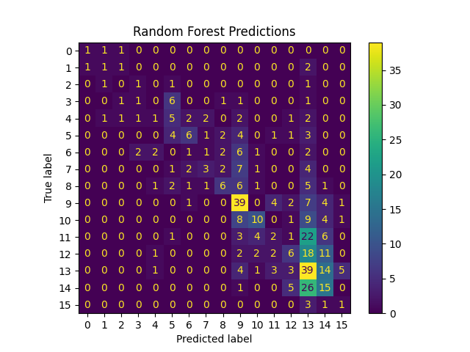
How did the models do?
Vanilla Random Forest Accuracy: 31.1%

Slide 9
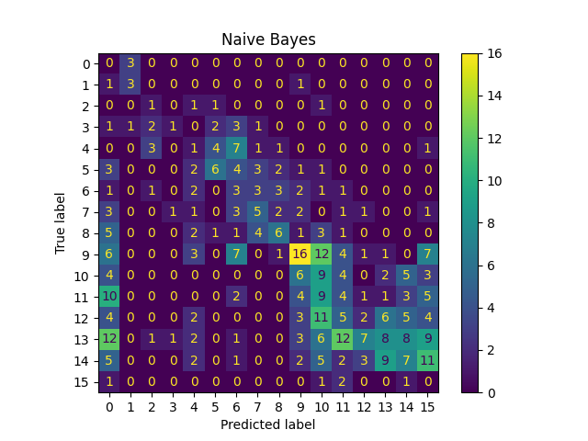
Vanilla Naive Bayes Accuracy: 17.2%

Slide 10
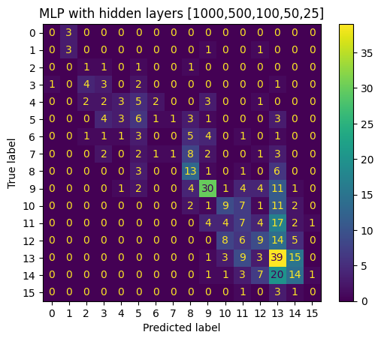
“Vanilla” MLP Accuracy: 33.0%

Slide 11
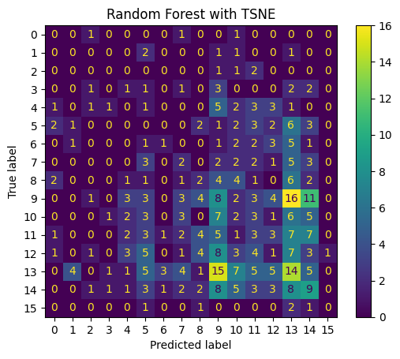
TSNE models
TSNE Random Forest: 10.0%

Slide 12
TSNE NB: 15.1%

Slide 13
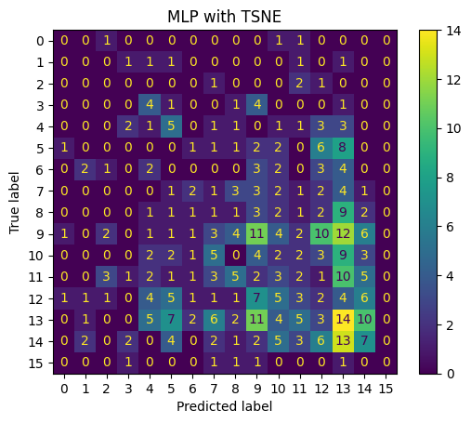
TSNE MLP: 10.0%

Slide 14
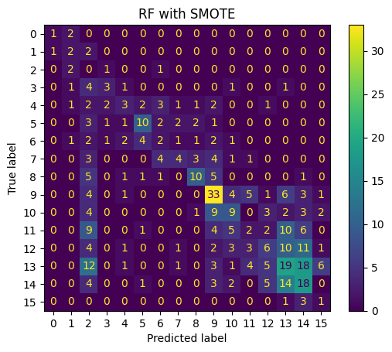
SMOTE models
SMOTE RF: 29.4%

Slide 15
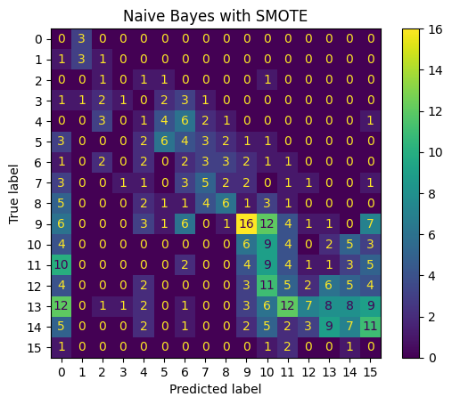
SMOTE NB: 17.0%

Slide 16
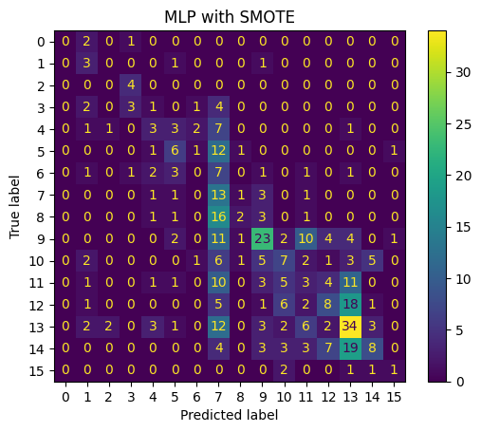
SMOTE MLP: 27.3%

Slide 17
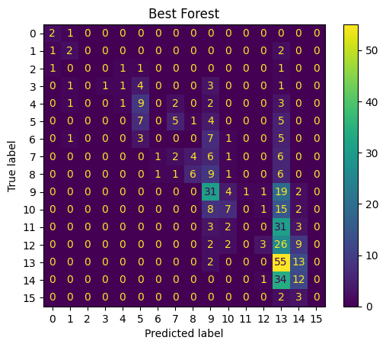
GridSearchCV on Random Forest
Best Vanilla: 31.0%

Slide 18
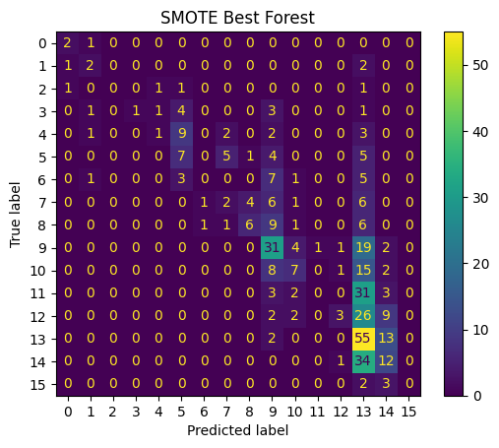
SMOTE
Best Model: 32.2%

Slide 19
What should be changed in the future?
More data can be gathered from the site, when not constrained as much by time.
Figure out which features were most important to the accuracy.
Fix the typo in the regex.

Slide 20
Questions?

Slide 21
Sources
https://ota.bodleian.ox.ac.uk/repository/xmlui/handle/20.500.12024/5 (Early English Books Online)

